Slide 1

Programming 101 With Ruby
Prepared and Taught by Lex Collette

Slide 2
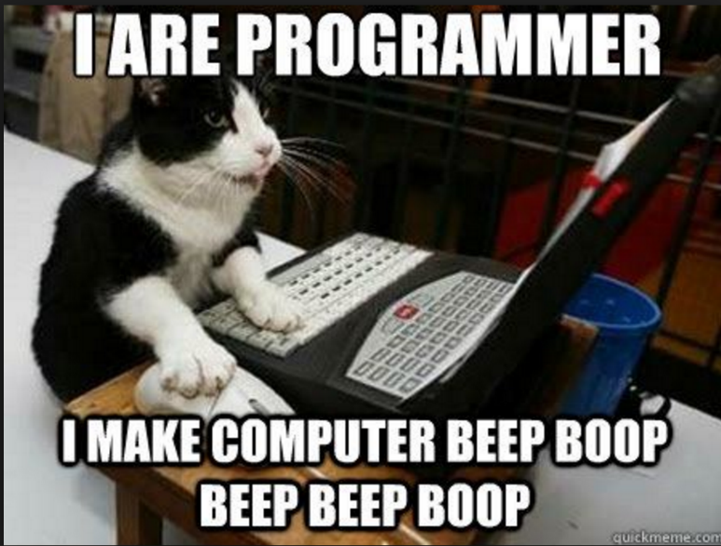
Why learn programming?
Teaches you to think!
A lot of non computer science careers involve some knowledge of programming either directly or indirectly.
Makes your computer a tool, not just an internet browser or word processor.
Gives you a better understanding of the technology around you.
You might find that you love it!

Slide 3
Why ruby?
One of the easier languages to learn
Often used for web development (you may have heard of Ruby on Rails)
Companies that use it:
Twitter, Goodreads, Kickstarter, Airbnb, GitHub, Hulu, Twitch, Urban Dictionary, and more!

Slide 4
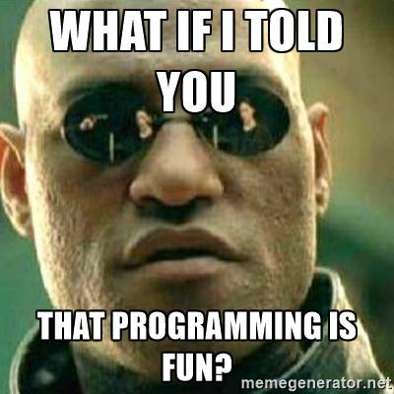
Programming Rules
Don’t be afraid to break it! It can always be fixed.
Don’t be afraid to experiment! Trying different ways of doing things helps you learn.
There is never just one way to write a program! Programming can be an art form.
No one is born knowing how to program! Takes practice to be a pro.
Ask questions!
HAVE FUN!

Slide 5



What we are going to use
To write our program we will be using Sublime Text
When we save it, we need to make sure we end the file name with ‘.rb’
Example
hello.rb
To run we will be using the terminal
Navigate (in terminal) to the folder you saved in
Then we will type:
ruby filename.rb
Don’t worry! We will review how to save and run as we go!

Slide 6
Your first Program!
Hello World!

Slide 7
Let’s GO!
If you haven’t already, go ahead and open Sublime Text
Save the file as hello.rb
Don’t forget the ‘.rb’ or it won’t work!
In the lower right hand corner of Sublime text it should now say ‘ruby’
That’s it!

Slide 8


Hello World
We use puts to tell the program that you want to print an output.
We will print what is inside the quotes.
This is often referred to as a “print statement”
To run it:
Save it
Open the terminal
Navigate to the folder that you saved your program in. (We will help!)
Then type:
Your first program!
You should see this:

Slide 9

You wrote your first Program!

Slide 10
Your Turn!
Print your own statement!
Add it to your current program

Slide 11

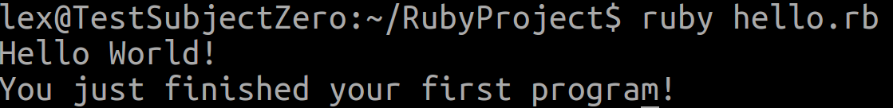
Hello World
Example:
To run it:
Save it
Open a terminal
Then type:
What it might look like:
Your turn to add your own print statement!
Notice how it printed it on a new line?
The puts adds a newline after the print statement.
We will learn how to stay on the same line soon.

Slide 12
Important Basics
What is a variable?
What is an Object?
What is a Comment?

Slide 13
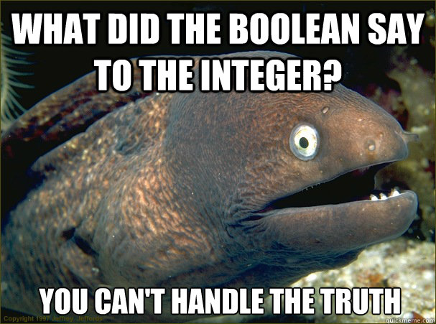
Variables
We use variables to store different kinds of data to memory and assign them to a name.
Variables have different data types.
Some different data types are:
String – a string of characters, such as a sentence
Character – a single letter, number or symbol
Integers – a whole number
Double – a number with decimals
Boolean – true or false
Allows us to recall and use stored data.
There are rules to naming variables:
All lower case letters.
Numbers can be used, but not as the first character.
_ (underscores) are allowed.
You can name them whatever you want, but we recommend choosing a name that describes what it is.
Avoid names that are part of the language such as puts.
Saves data

Slide 14
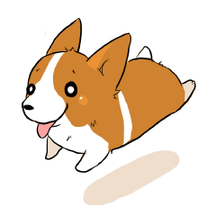
Objects
Almost everything in Ruby is an object
Think of an object like a puppy
They will listen to certain commands
If we were to put them into programming commands they might look like:
puppy.sit
puppy.stay
puppy.fetch
Different types of things have different types commands you can use.
You can say puppy.shake
You can’t say puppy.play_trumpet
Everything in Ruby is an object
For example, Strings and integers will have different commands available
We will visit a few as we go!

Slide 15
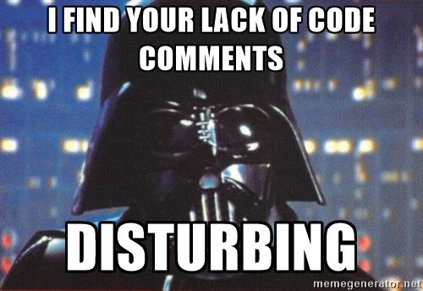
Comments
Comments are used to make notes in your code.
Makes it more readable for yourself and others.
In Ruby we put a # in front of what you want to comment.
Anything that is commented will not be read by the program
This is how to put notes (referred to as comments) in your code

Slide 16
Hello #{name}!
User input

Slide 17

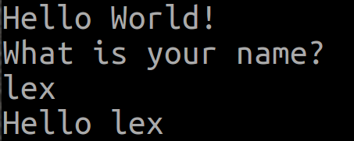
Hello #{name}!
name is a variable that will store the user’s name in a string.
gets reads input from the keyboard.
.chomp removes a newline when input is entered. Used for formatting.
#{name} tells the program to output the variable name.
To run it:
Save it
Open a terminal
Then type:
Let us greet the user by name!
Should look something like:

Slide 18
Hello #{name}!
Get fancy with it!
Try this instead:
What do you think it will do?
What did it do?
Getting all fancy with objects.

Slide 19
Mini Review
what did what
How we did the things
Strings
Variables
Comments
Objects
puts– Prints out the line followed by a new line.
gets – reads the user input.
.chomp – formats input
.capitalize – Capitalizes the first letter of a string.

Slide 20
Numbers
Basic math stuff

Slide 21
Let’s GO!
In Sublime Text, click File->New File
Save the file as math.rb
Don’t forget the ‘.rb’ or it won’t work!
In the lower right hand corner of Sublime text it should now say ‘ruby’
That’s it!

Slide 22
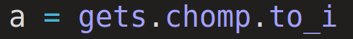
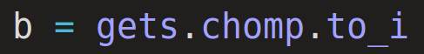
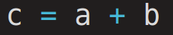
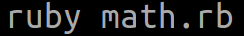
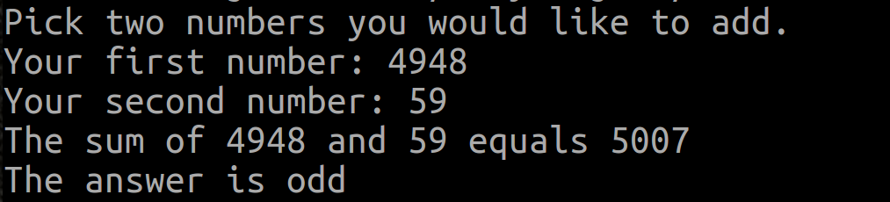
Basic Math
print allows us to have the input on the same line for formatting purposes.
.to_i tells the program we want to read an integer, not a string.
This will allow us to do math functions with it.
We will set the new variable c to the sum of a and b.
To run it:
Save it
Open a terminal
Then type:
Let’s do some basic math
Should get something like:

Slide 23
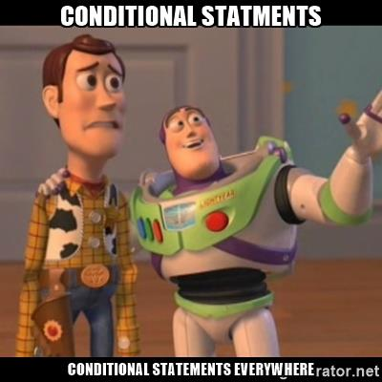

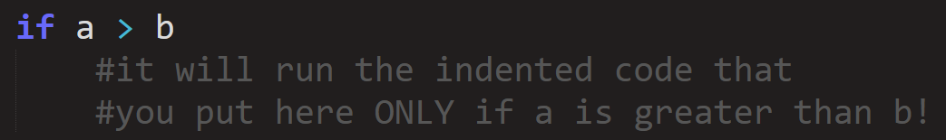
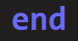
Conditionals
A conditional statement only occurs if a condition is met.
Today we are going to learn if statements
This is what it looks like:
The expression (a > b in this case), must have a true or false result.
To tell the computer that we are done with the if statement we must include end
If the expression is true, it will execute the code in between the if and the end
What if… ?

Slide 24
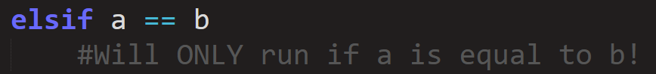
Conditionals
What if we want to check something else if the first expression is false?
You can use an elsif:
Takes an expression just like the original if.
It is still part of that if. Shares the end with the if.
You can have an if without an elsif, but you can’t have an elsif without an if!
What if… ?
Why not just have another if?

Slide 25
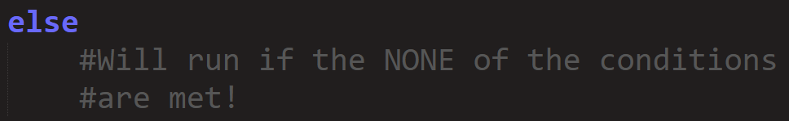
Conditionals
What if the conditions of the expression were not met?
You can use an else:
Does NOT take an expression!
It is still part of that if. Shares the end with the if.
What if… ?
You can have an if without an else, but you can’t have an else without an if!
There can only be one else to an if. Why?
Why is else important?

Slide 26
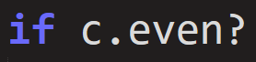
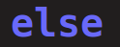
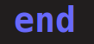
If…
Checking to see if the answer is even
PUT THE end marker in now so you don’t forget!
Let’s tell the user about it if it is even
What if we want to know if something is odd or even?
What will we tell the user in the else statement?
It’s odd!
TESTING TIME!

Slide 27
Basic Math
To run it:
Save it
Open a terminal
Then type:
Let’s do some basic math
It should look similar to:

Slide 28
Your Turn!
Include a third number
check for an odd number instead of even

Slide 29
Basic Math
Your task:
Add a third number to do math with
Include it to your calculations
Check for odd instead of even
To run it:
Save it
Open a terminal
Then type:
You can use +, -, *, / and % (this is modulus not percent)

Slide 30
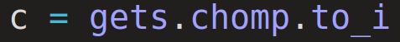
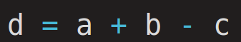
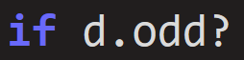
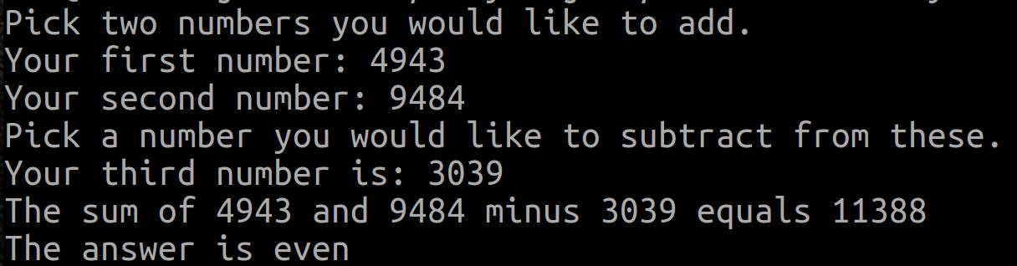
Basic Math
Your code might look like:
You can use +, -, *, / and % (this is modulus not percent)
Your output might look like:

Slide 31
Mini Review
what did what
How we did the things
Integers
Operators (+, -, /, *)
print
.to_i
.even?/.odd?
If/else end

Slide 32
Now for the good stuff
Number guessing game

Slide 33
Goals
We are going to make a game!
Ask the user to think of a number 1-10
The program will guess a number at random within the range
It will ask the user if the number is correct, higher, or lower until it finds the number.
Will make sure the user does not cheat
It will find the users number
Game time

Slide 34
Let’s GO!
If you haven’t already, go ahead and open Sublime Text
Save the file as game.rb
Don’t forget the ‘.rb’ or it won’t work!
In the lower right hand corner of Sublime text it should now say ‘ruby’
That’s it!

Slide 35

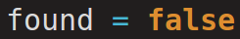
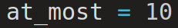
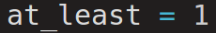
Let’s Start
found is considered a Boolean. It can ONLY be true or false.
at_most will be the highest number one can guess
at_least will be the lowest number one can guess
Then we will ask the user to think of a number!
Why do you think we use the variables in the print statement instead of just typing in the numbers?
Getting some basics in place
Now it’s time to learn about loops!

Slide 36
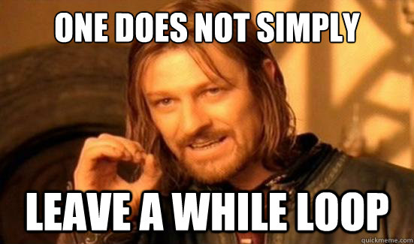

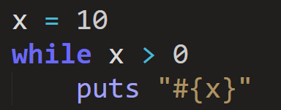
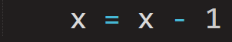
LOOPS
A loop is a bit of code that will repeat until a condition is met.
Today we will learn about while loops!
They look something like this:
The while loop takes an expression that must be true or false. Just like we did with if statements.
We end it just like an if statement too!
Doing stuff until we stop doing stuff
The code in the while loop will repeat until the condition is met.
There is something horribly wrong with this code!
Can you find the mistake?
Our variable x was not changing, so we would have looped forever! Or at least until it crashed our computer.

Slide 37
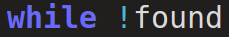
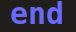
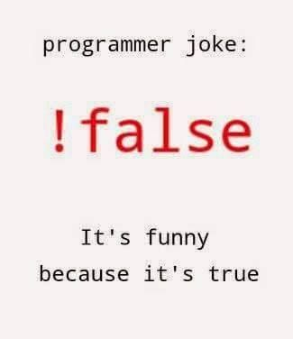
Adding a loop
An ‘!’ (exclamation point) negates a thing
In this case ‘while !found’ means ‘while found is false’
It is good practice to include the end marker right away so you don’t forget it later.
Loop-da-loop
We will be adding code in between.

Slide 38
Random Number
randomNum is going to be a random integer.
rand(at_least..at_most) will give us a random integer between at_least and at_most
The computer will take a guess
Let’s ask the user if it is the right number!
We say (y/n) at the end of the question to let the user know what the expected input is.
What would happen if we tried to test it right now?

Slide 39
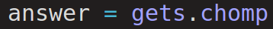
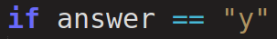
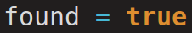
Was it right?
Checks to see if it guessed the correct number.
Let’s store the user’s answer as a variable.
if the user’s answer equals y what should we do? (Don’t forget to end!)
We must make sure that we end the loop by setting found to true.
Inform the user that it was correct!
Can we test it now?

Slide 40
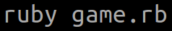
Test it!
Does it work?
To run it:
Save it
Open a terminal
Then type:

Slide 41
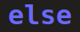
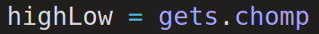
Was it Wrong?
else will occur if any other answer but y is given.
Find out if the answer is higher or lower than the guessed number.
Silly computer. That is not my number.
Store it in a variable!

Slide 42
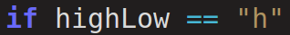
Change the guessing range
Checks to see if it guessed the correct number.
This time we want to check for both higher and lower
if will first check for higher (h). Don’t forget to end it!
We are going to update the at_least. Why?

Slide 43
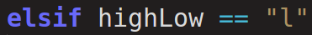
Change the guessing range
Checks to see if it guessed the correct number.
We use elsif to check the answer for l if it is not h.
There is no need to end it because the if handles it.
Why would we not just use another if?

Slide 44
Change the guessing range
Checks to see if it guessed the correct number.
We are going to update at_most in this case.
Why do we add or subtract 1 when we update our variables?

Slide 45
Change the guessing range
Checks to see if it guessed the correct number.
What if the user doesn’t select a correct option?
We should NOT change at_least or at_most!
Go ahead and tell the user that it was invalid.

Slide 46
Test it!
Checks to see if it guessed the correct number.
To run it:
Save it
Open a terminal
Then type:

Slide 47

Did they cheat?
Checks to see if it guessed the correct number.
We will now check if the user cheated!
The two lines (||) mean or
Why do these checks work?
Tell the user that they cheated!

Slide 48
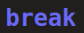
Did they cheat?
Checks to see if it guessed the correct number.
break is another way to end the loop.
The while loop will end even though we didn’t set found to true
Lets Play!

Slide 49
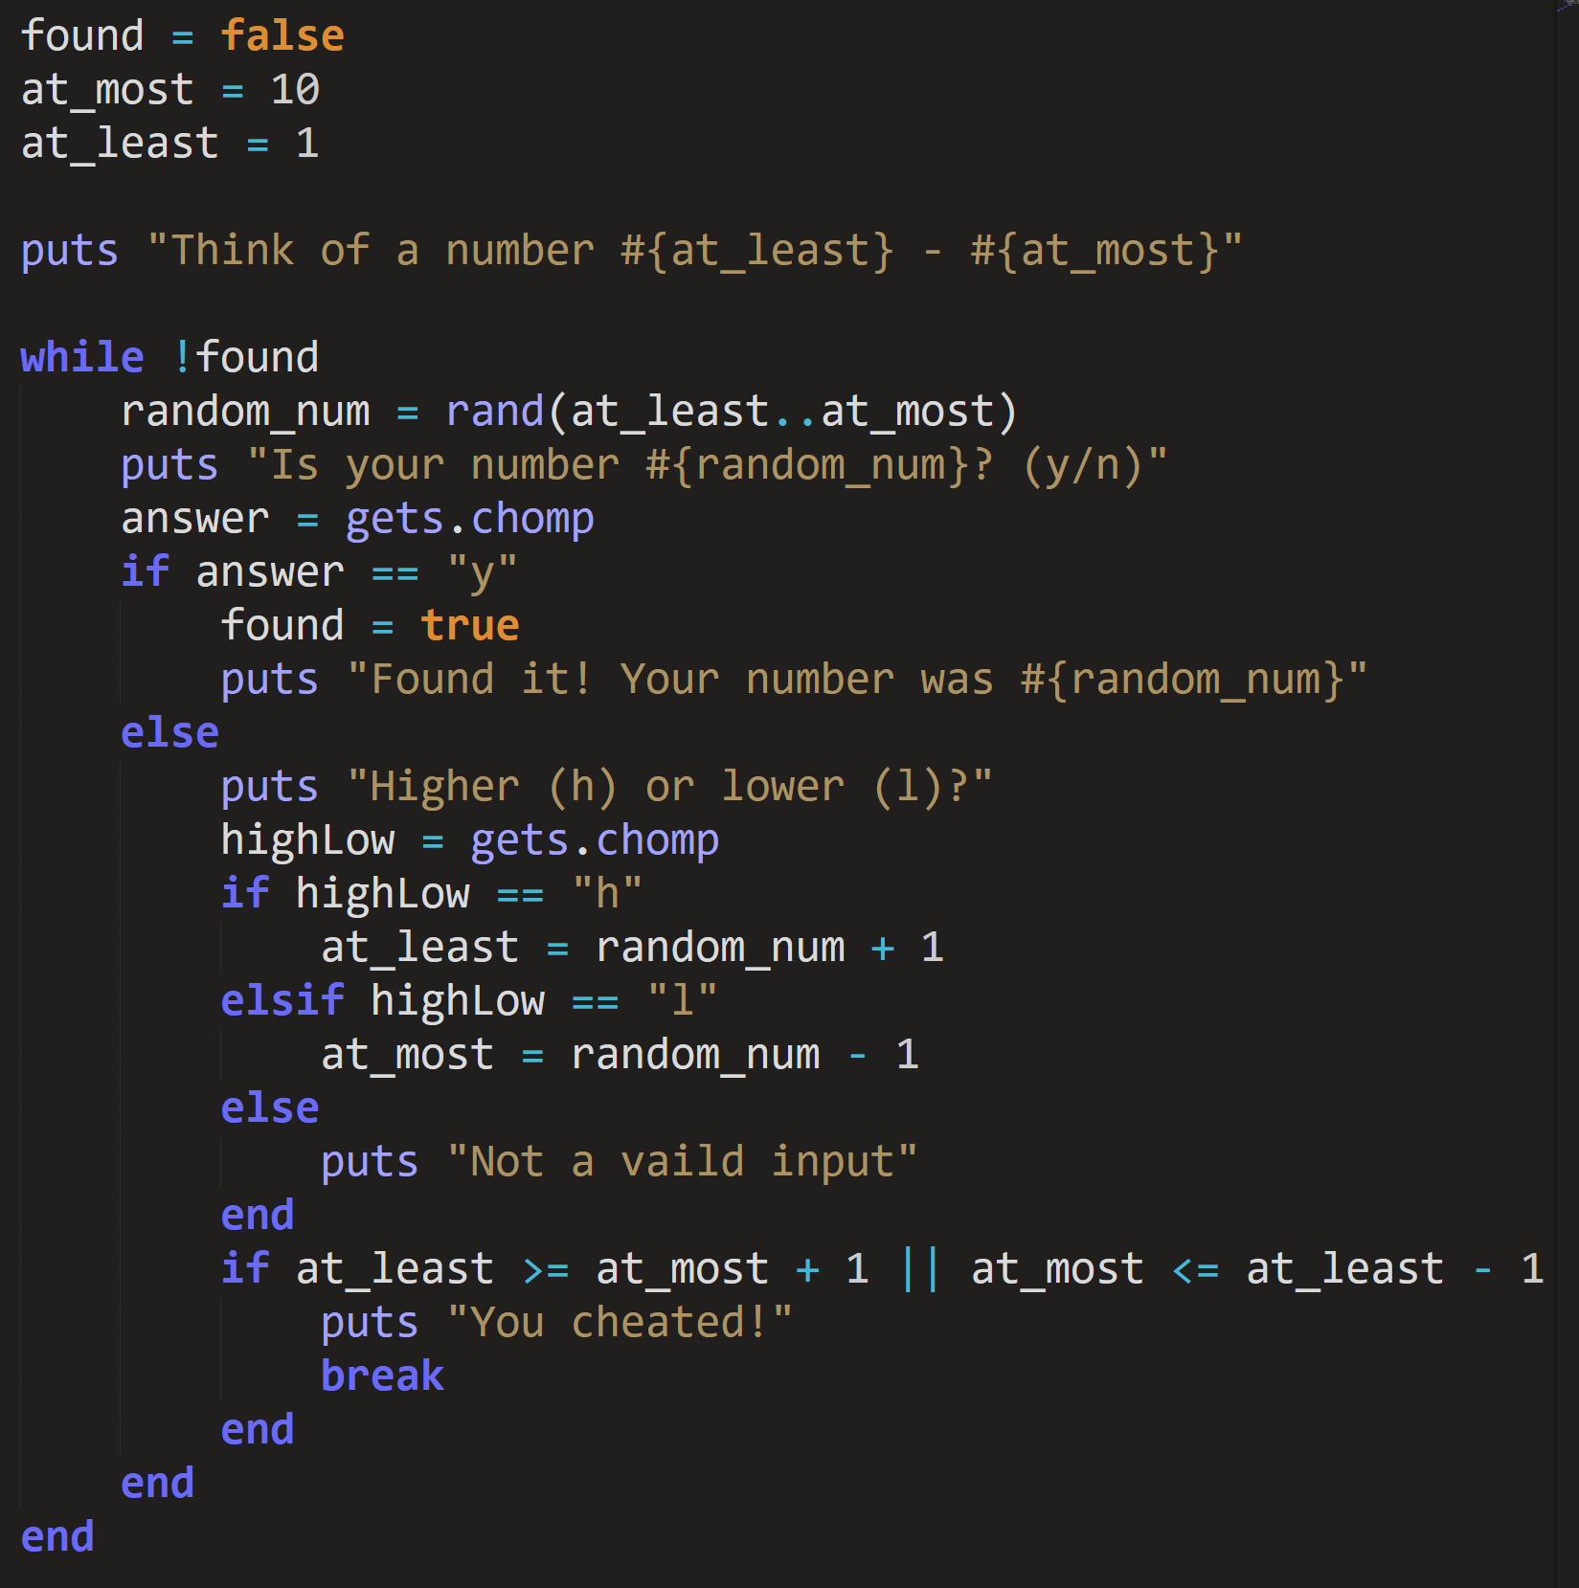
Final Code
Should look something like this

Slide 50
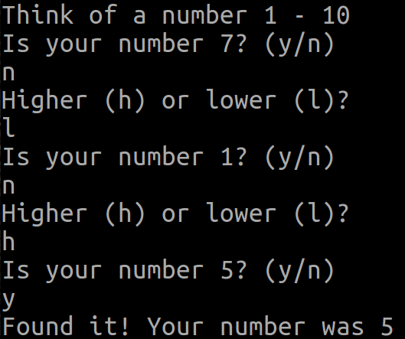
Final Test Run
To run it:
Save it
Open a terminal
Then type:
Should look something like:
Should look something like this

Slide 51
Want to learn more?
codecademy.com/learn/ruby<- runs in a browser
tryruby.org <- runs in a browser
railsforzombies.org/ <- walkthrough to make a twitter for zombies!
www.lynda.com/Ruby-tutorials/ <-use your school login
learnrubythehardway.org/book/ <-gets more in depth
Additional FREE resources to practice your new found coding skills!

